Slide 1


Water Chemistry for
Homebrewing
Andy Mitchell

Slide 2
Beer is mostly WATER
Is MY water good for brewing?
Does it TASTE good?
Does it LOOK good?
Go for it!

Slide 3
Water Profile
Why is water chemistry important….
Mash pH
Enzyme reactions in the mash
Chemical reactions in the boil
Yeast health

Slide 4
Water Profile
Carbonate (CO₃²⁻)
Bicarbonate (HCO₃⁻)
Calcium (Ca²⁺)
Magnesium (Mg²⁺)
Chloride (Cl⁻)
Sulfate (S0₄²⁻)
Sodium (Na⁺)

Slide 5
Hardness
The total amount of calcium (Ca²⁺), magnesium (Mg²⁺) ions dissolved in your water

Slide 6
Alkalinity
The ability of water to resist a drop in pH

Slide 7
Malt and Mash pH
3Ca²⁺ + 2HPO₄²⁻ <-> 2H⁺ + Ca₃(PO₄)₂
From Water From Malt Precipitates
H⁺ + HCO₃⁻ -> H₂O + CO₂
From Water

Slide 8
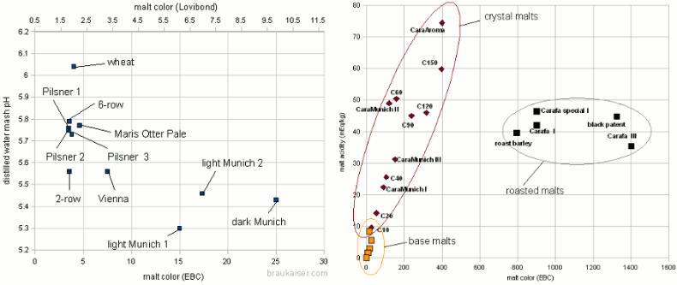
Malt and Mash pH

Slide 9
Calcium (Ca²⁺) in the Mash
Lowers pH
Precipitates proteins
Optimizes environment for mash enzymes
Ideal Range: 50-100 ppm
Fort Collins: 16.8 ppm

Slide 10
Calcium (Ca²⁺) in the Boil
Precipitates proteins (hot break)
Precipitates calcium oxalate (beer stone)
Reduced color formation
Ideal Range: 50-100 ppm
Fort Collins: 16.8 ppm

Slide 11
Calcium (Ca²⁺) During Fermentation
Aids in flocculation
Ideal Range: 50-100 ppm
Fort Collins: 16.8 ppm

Slide 12
Sodium (Na⁺)
Adds a “sweetness” to finished beer
Too much will add a salty flavor
Not necessary for any chemistry
Ideal Range: < 150 ppm
Fort Collins: 3.2 ppm

Slide 13
Magnesium (Mg²⁺)
Used by yeast during fermentation
Ideal Range: 10-15 ppm
Fort Collins: 1.6 ppm

Slide 14
Chloride (Cl⁻) and Sulfate (SO₄²⁻)
Chloride enhances “fullness” and “maltiness”
Sulfate enhances “dryness” and “bitterness”
Cl Ideal Range: < 200 ppm
Fort Collins: 2.5 ppm
SO₄ Ideal Range: < 150 ppm
Fort Collins: 12.0 ppm

Slide 15
Chloride (Cl⁻) and Sulfate (SO₄²⁻)
Cl:S0₄ ratio determines the balance
0.5 1.0 1.5
Bitter / Dry Balanced Malty / Full
Fort Collins Cl:S0₄: 0.2

Slide 16
Brewing Salts and Acids
Name Forumla Mash pH CL:SO₄
Calcium Chloride CaCl₂
Calcium Sulfate (gypsum) CaSO₄
Calcium Carbonate (chalk) CaCO₃
Epsom Salt MgSO₄
Baking Soda NaHCO₃
Table Salt NaCl
Lactic Acid

Slide 17
Examples!

Slide 18
My Process
Add MgSO₄ to the boil Mg: 12-14 ppm
Add CaCl₂ / CaSO₄ to the mash Ca: 80-100 ppm
Add CaCl₂ / CaSO₄ to the boil Ca: 80-100 ppm
Adjust balance to adjust Cl:SO₄

Slide 19
My Process
For pale beers add lactic acid if needed
For dark beers add chalk (CaCO₃) if needed
For very dark beers add baking soda (NaHCO₃)
If chalk was added adjust calcium additions

